Slide 1
OCD Patient Dataset: Demographics & Clinical Data Analysis

Slide 2

Unveiling Insights: A Data-Driven Approach to OCD Research
This presentation outlines our data-driven approach to understanding Obsessive-Compulsive Disorder (OCD) using a comprehensive patient dataset. We aim to explore demographic and clinical relationships and predict medication usage through machine learning.

Slide 3
Research Objectives
Perform Exploratory Data Analysis (EDA)
Understand Relationships
Predict Medication Use
Analyze correlations between demographic factors, clinical outcomes, and symptom presentations.
Apply and evaluate various machine learning models to predict medication usage based on patient characteristics.
Conduct an in-depth EDA on the OCD patient dataset to uncover initial patterns and data quality issues.

Slide 4

Dataset Overview
Patient Records: 1500 anonymized OCD patient records.
Demographics: Includes Age, Gender, Ethnicity, Marital Status, and Education Level.
Clinical Information: Y-BOCS scores (Yale-Brown Obsessive Compulsive Scale), primary and comorbid diagnoses, medication history, and symptom duration.
Data Richness: Provides a holistic view of patient profiles for comprehensive analysis.

Slide 5




Initial Data Exploration
Our initial steps involved robust data integrity checks and feature profiling to prepare for in-depth analysis.
Data Quality Checks
Missing Value Visualization
Feature Identification
Thoroughly inspected for null values, inconsistent data types, and performed basic statistical summaries to understand data distribution.
Utilized a heatmap to visually represent missing values, identifying patterns and potential data entry issues.
Categorized features into numerical and categorical types to apply appropriate analytical methods for each.

Slide 6

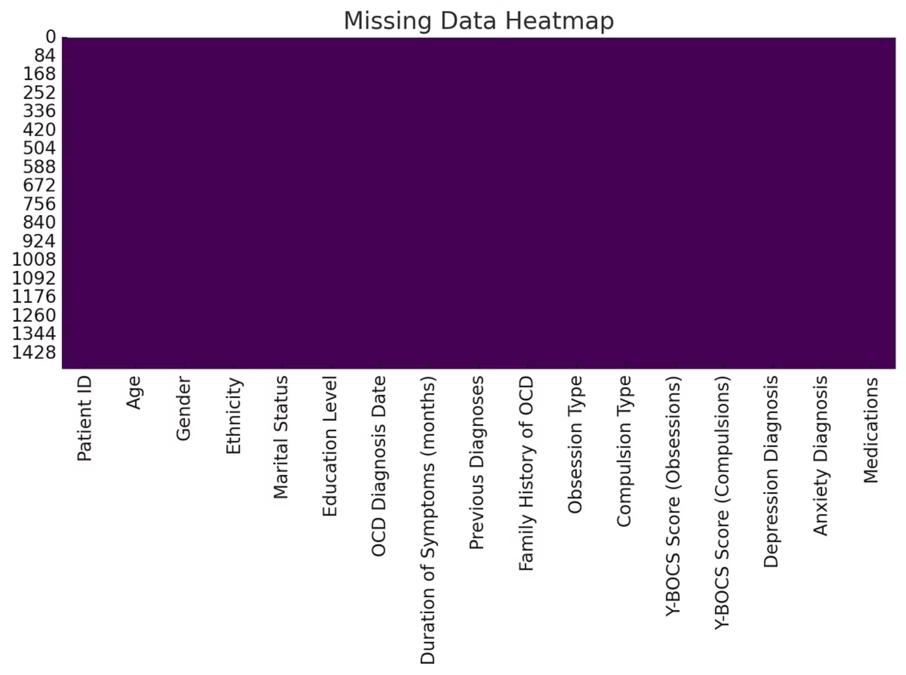
Missing Data Heatmap
The heatmap clearly visualizes the distribution of missing data across our dataset. Darker areas indicate a higher prevalence of missing values, guiding our data imputation and cleaning strategies. This step was crucial for ensuring the reliability of subsequent analyses.

Slide 7
Feature Importance (XGBoost)
XGBoost analysis revealed key features influencing medication decisions in OCD patients.
Duration of Symptoms
Age
The longest-standing and most impactful predictor, indicating chronic symptomology is a strong factor.
Patient age plays a significant role, potentially reflecting disease progression or treatment history.
Education Level
Family History
Education level emerged as an important feature, possibly influencing health literacy or access to care.
A strong indicator, suggesting genetic or environmental predispositions impact medication choices.

Slide 8
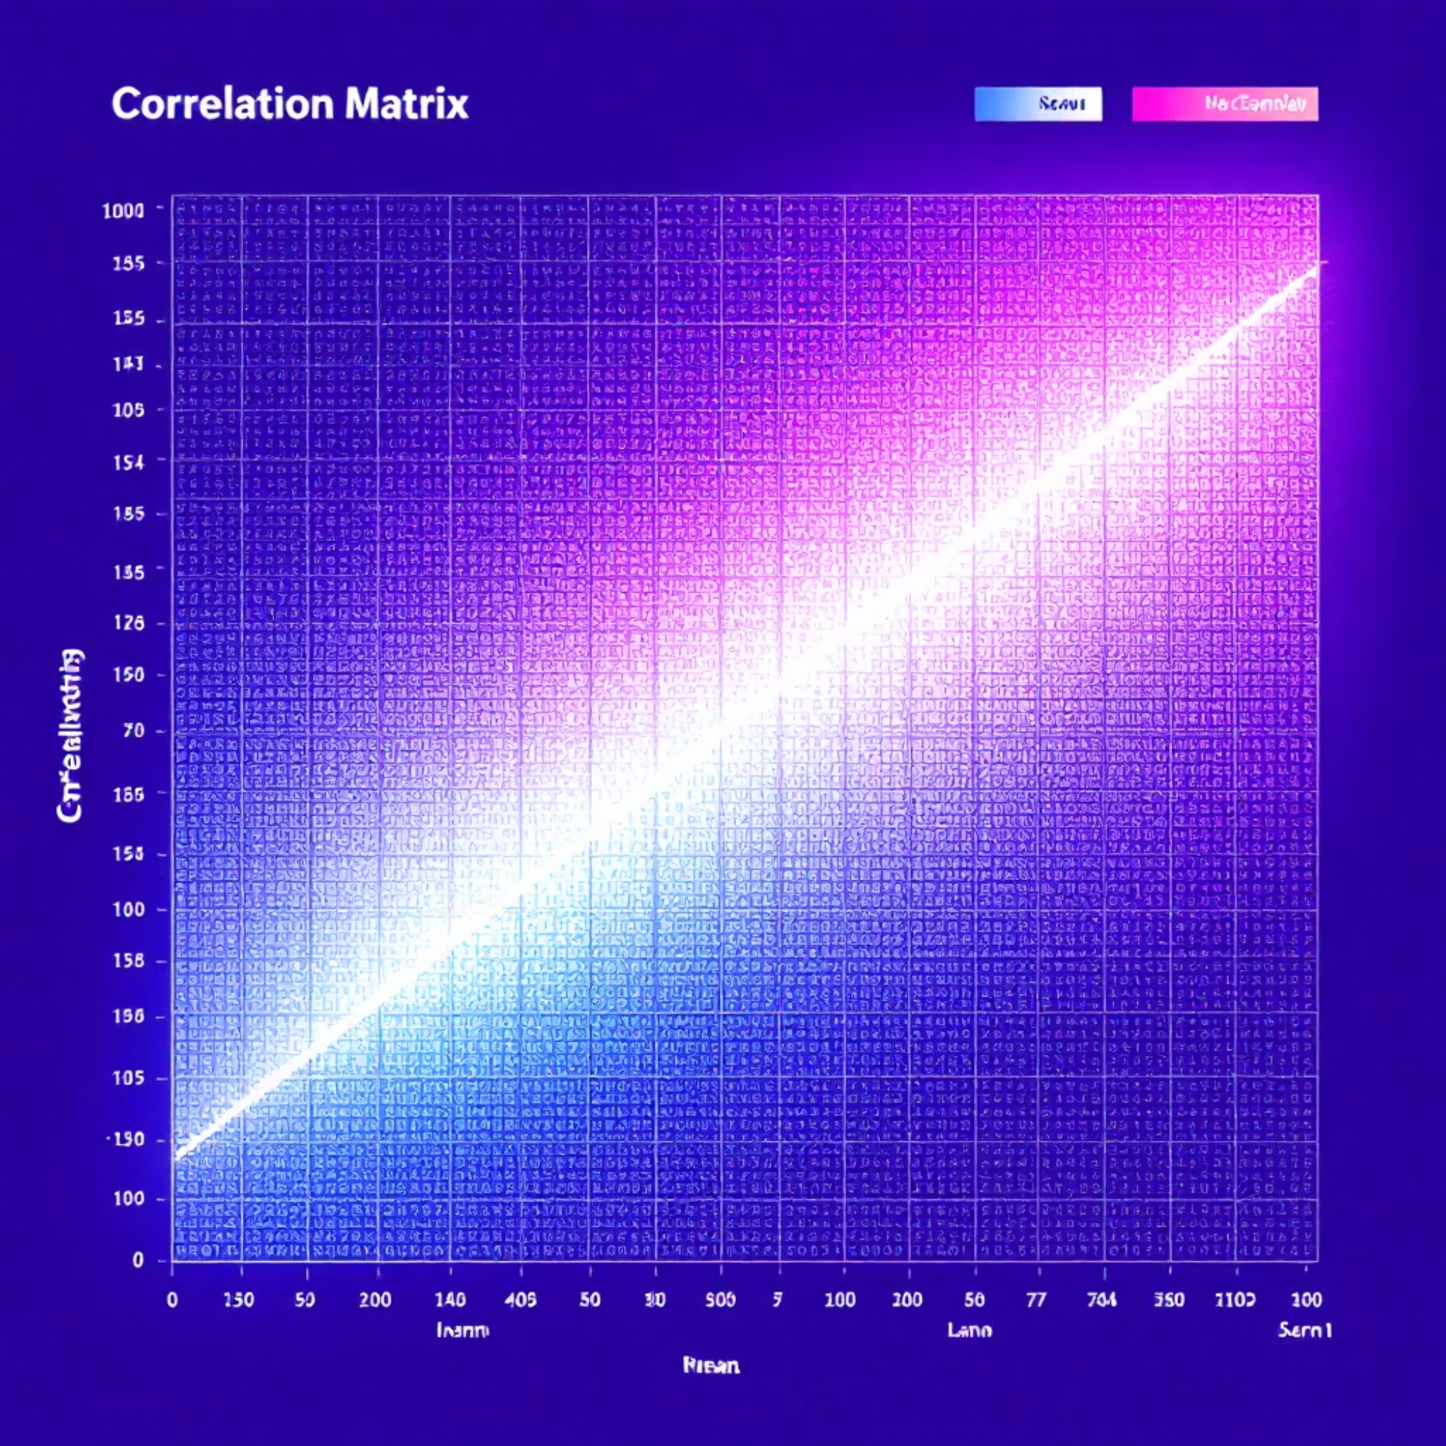
Correlation Matrix
The correlation matrix provides a visual summary of relationships among numerical features in the dataset.
Y-BOCS Scores: A strong positive correlation was observed between Y-BOCS Obsession and Compulsion scores, as expected, indicating their intertwined nature.
Symptom Duration: Moderate correlations with Y-BOCS scores suggest that longer symptom duration may be associated with increased severity.

Slide 9



Machine Learning Models Applied
We deployed a suite of diverse machine learning models to predict medication classification.
Individual Models
Ensemble Approach
Target Variable
SVC, Logistic Regression, XGBoost, Random Forest, and LightGBM were individually trained and evaluated.
A VotingClassifier was implemented to combine the strengths of multiple models, aiming for improved robustness.
The primary objective was the classification of medication use (e.g., presence or type of medication).

Slide 10
Model Evaluation & Insights
Voting Classifier Performance
Key Data Insights
The ensemble Voting Classifier achieved an accuracy of approximately 30.5%.
Demographics: Gender and Ethnicity show balanced representation, ensuring broad applicability of findings.
Confusion Matrix: Detailed analysis revealed specific areas of misclassification, indicating challenges in distinguishing certain medication categories.
Comorbidity: A significant portion of patients presented with comorbid anxiety or depression.
Challenges: This suggests room for improvement in feature engineering and addressing potential class imbalance within the dataset.
Medication Trends: The majority of patients were prescribed SSRIs.
Severity Link: Symptom duration demonstrated a strong correlation with overall Y-BOCS severity scores.

Slide 11
Conclusion & Future Directions
Future Scope
Valuable Insights Gained
Future work will focus on improving model accuracy through deep learning, leveraging NLP for textual diagnostic data, and exploring more advanced feature engineering techniques.
Project Accomplishments
Insights into OCD patient demographics, symptom patterns, and the influencing factors behind medication decisions were generated.
Successfully completed EDA, identified key feature relationships, and applied machine learning models for medication prediction.

